Slide 1
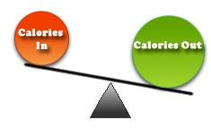
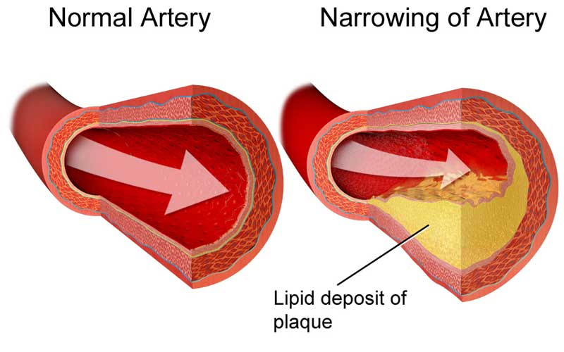
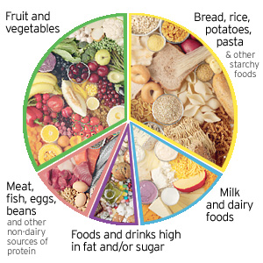
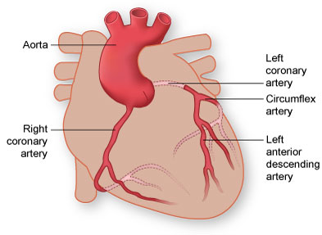
B1 Diet and exercise
What is a healthy diet? | A diet that contains the right balance of nutrients and the right amount of energy for the person’s needs. | Define metabolic rate | The speed at which chemical reactions are carried out inside body cells.
What are the main nutrients in a healthy diet and what are they needed for? | Fats for insulation and energy Carbohydrates for energy Proteins for growth and repair Vitamins and minerals for health and to prevent deficiency diseases | What affects metabolic rate? | Age Gender Exercise Genes Proportion of muscle to fat in the body
What does an unhealthy diet lead to? | Being malnourished. | How do you lose weight? | Increase your metabolic rate through exercise. The more you exercise, the more muscles you develop and so the proportion of muscle to fat changes. Ensure your energy intake is less than your energy usage.
Give examples of being malnourished | Obese, underweight, having scurvy or rickets, developing type 2 diabetes
What can obesity lead to? | Arthritis, stroke, heart attack, blood clots, high blood pressure
What is cholesterol? | A plaque like substance in the blood that can build up inside arteries
What determines how much cholesterol you have in your blood? | The genes in your liver (the liver produces cholesterol) and your diet
Why can cholesterol give you a heart attack? | As cholesterol builds up inside the arteries leading to the heart, a blood clot can form and the heart is prevented from receiving oxygenated blood. This causes heart cells to die and the heart stops working fully. The result is a heart attack. Arteries supplying the heart with blood are called coronary arteries.
What are statins? | Drugs that stop the liver from producing cholesterol.
Give a disadvantage of using statins. | People might not change their diet and lifestyle and continue eating unhealthily.

Slide 2
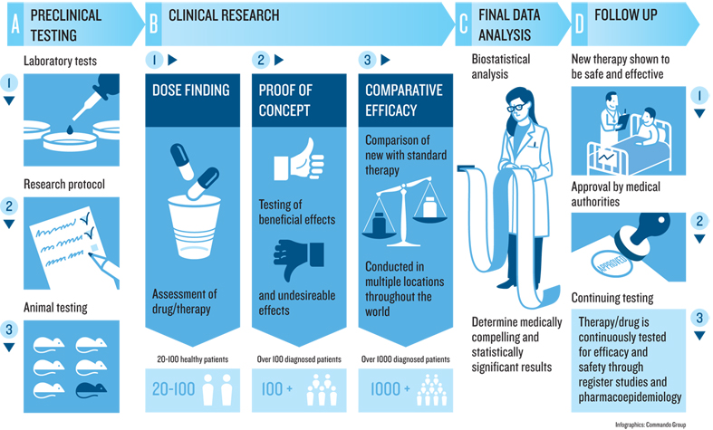
B1 Drugs
What is a drug? | A chemical that changes chemical reactions in the body | What is happening in Phase 3 drug testing? | The drug is given to many patients to determine the optimum dose.
Name recreational drugs that are legal and illegal | Legal: alcohol, caffeine, nicotine Illegal: heroine, cocaine, ecstasy, cannabis | What is a placebo? | A dummy drug given to patients in Phase 3.
Why are drugs dangerous? | Because they change the body chemistry, they lead to addiction. When you try and stop taking the drug you experience (painful) withdrawal symptoms. | What is a double blind trial? | In Phase 3, some patients are given the drug and some are given a placebo. Neither the doctors nor the patients know who received the drug/placebo.
 |  | What was Thalidomide developed for? | As a sleeping pill
Why do doctors have to prescribe drugs? | Because many medicines are addictive.
 |  | Why was Thalidomide given to pregnant women? | To treat morning sickness
 |  | Side effects of Thalidomide on babies | Severe limb deformities
Which drugs have the biggest impact on society? | Legal recreational drugs because they are so easy to get hold of and can be bought and consumed in large quantities.
 |  | Today’s use of Thalidomide | To treat Leprosy
What are steroids used for? | To boost heart rate and increase muscle growth. It is a performance enhancing drug.
What are the dangers of cannabis? | In some people it can lead to mental illnesses such as paranoia, depression, schizophrenia. In men it can lead to infertility.
What is the impact of nicotine/caffeine on the body? | Both are stimulants and increase the heart rate.
What do scientists try to find out about drugs in pre-clinical testing? | Tests are done on cells and tissues to check if the drug is toxic to humans, to see if the drug works and to find potential side effects and doses.
What do scientists try to find out in Phase 1 testing? | Healthy volunteers are given the drug to see if there are any damaging side effects or interactions with other drugs.
What do scientists try to find out in Phase 2 testing? | The drug is given to ill patients to see if the drug treats the disease.

Slide 3
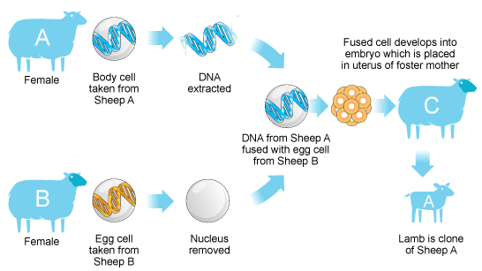
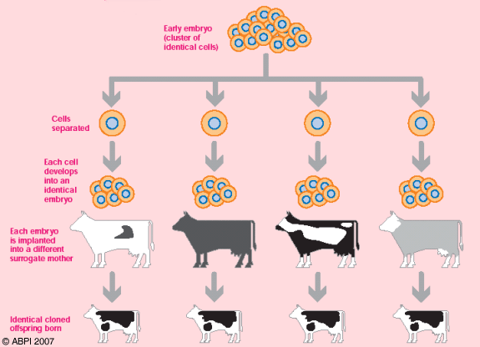
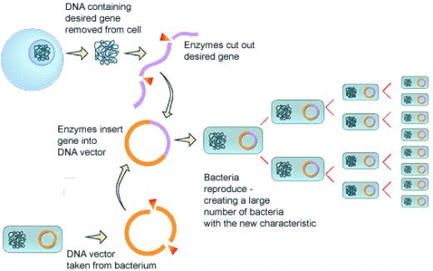
B1 Variation, Reproduction and new technologies
What are chromosomes and where are they? | Chromosomes are coiled up pieces of DNA which are found inside the nucleus of every cell. | Tissue cultures | Remove some plant cells. Grow these cells into new plants in the lab (large scale cloning method)
What are genes and what is their purpose? | Genes are sections of chromosomes. Genes give us our characteristics. Different genes cause different characteristics. | Embryo cloning | Remove unspecialised cells from an embryo. Grow each cell into a new embryo and transplant this into womb of host mother.
What is sexual reproduction? | When a male and female gamete meet and fuse. Two parents are needed. | Adult cell cloning. | Remove nucleus from egg cell. Remove nucleus from adult body cell and transfer into empty egg cell. Electrocute cell so it starts to divide and form an embryo. Transplant the embryo into womb of host mother.
What is asexual reproduction? | When the genetic material of one parent is cloned.
 |  | Animal cloning advantages | Animals that have medicinal properties can be cloned and used for humans. Loved pets are cloned. Animals can be saved from extinction.
What is a gamete? | A sex cell. E.g. sperm, egg cell
Advantage of sexual reproduction | Leads to variety which means the species is more likely to survive if there is a change in conditions to the environment. | Animal cloning disadvantages | Lack of variety Unethical
Disadvantage of sexual reproduction | Slow; you need to wait for a male and female gamete to meet and fuse. | How does genetic engineering work? | Use enzyme to cut out desired gene. Insert the gene into bacteria DNA (plasmid). Wait for the bacteria to multiply. Gene can also be directly inserted into plant and animal DNA.
Advantage of asexual reproduction | Cheap and quick. Thousands of identical plants can be grown in the lab to be sold.
 |  | Genetic engineering advantages | Increases crop yield as the GM crops are resistant to insects and herbicides (weedkillers)
Disadvantage of asexual reproduction | No variety. This means a change in the environmental conditions could wipe out an entire species. | Genetic engineering disadvantages | We don’t know if GM crops have an impact on human health. GM crops might interfere with wild flowers and bees.
Examples of variation due to environmental conditions | Drinking while pregnant: baby can be born with learning difficulties or be smaller Skin and hair colour also depend on the climate
Cloning plants using cuttings | Cut off a part of a plant. Add a growth hormone. The cutting will grow roots and form the new plant

Slide 4
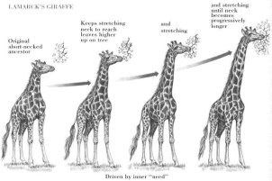
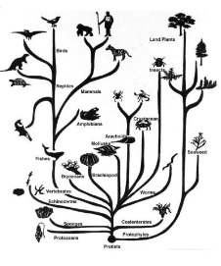
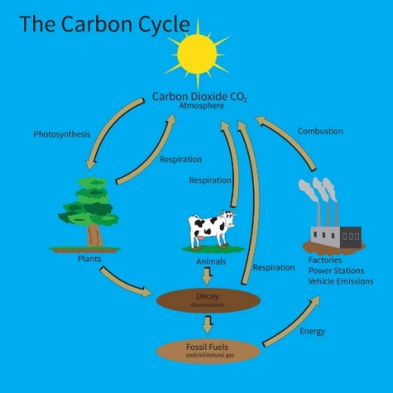
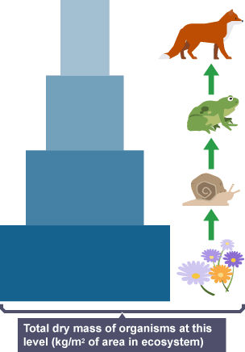
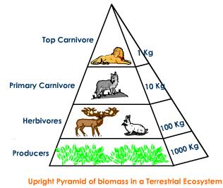
B1 Evolution – Biomass and Energy in food chains
Darwin’s Theory | All organisms have evolved from simpler life forms over millions of years | How do you calculate biomass? | Mass of each organism x number of that organism
Why no one believed Darwin at the start | His idea went against religious beliefs There was little evidence (e.g. fossils) No one knew about genes yet | Nutrients are recycled in nature because… | Organisms die and decay and return the nutrients back to the environment
Lamarck’s theory | Any changes to an organism that were acquired during its lifetime were passed on to the offspring (e.g. scars, lengthening of the neck of giraffes) | What is decay? | When a living organisms is broken down by micro-organisms
 |  | What are the best conditions for decay? | Aerobic, moist and warm environments.
How does evolution take place? | Via natural selection. Genes that cause characteristics that help an animal survive are passed on to the offspring.
 |  | Describe the Carbon cycle | Photosynthesis by plants and algae removes CO₂ from the environment to make glucose, fats and proteins. Carbon is passed from plant to animal through feeding. Plants, animals and micro-organisms respire and return CO₂ into the environment. When plants and animals die and decay, micro-organisms feed on the dead material, respire and return CO₂ into the environment. Burning of fossil fuels and wood also releases CO₂ into the environment.
Why can evolution happen more quickly? | Sometimes genes mutate and give an animal an advantage. This allows it to survive and breed and pass on the genes to the offspring.
What does an evolutionary tree show? | How animals are related to each other. It is used to classify animals.
Where does all the energy come from? | The Sun
What is biomass? | The mass of a living organism
What happens to the biomass at each level in a food chain? | It reduces
What happens to the energy passed on to each level in a food chain | It reduces
Why is there a reduction in energy passed to each level in the food chain? | Energy is used by the organism for movement, growth. Most is lost to the environment. Only a little is stored as biomass.

Slide 5
B1– Hormones and reflexes
Geotropism | Growing towards the growth of gravity (e.g. roots) | Which body functions do hormones control? | Blood sugar levels, water levels, ion levels, reproductive system.
Phototropism | Growing towards light (e.g. plant shoots) | Describe how hormones control the menstrual cycle | FSH is released by the pituitary gland to start the ripening of eggs in the ovaries. LH is released which causes the egg to be released from the ovaries. FSH causes the ovaries to release oestrogen. The oestrogen stops further FSH production so only one egg at a time becomes mature and is released.
What do roots respond to? | The force of gravity and moisture
What do plant shoots respond to? | light
 |  | Describe how hormones are used in contraceptive pills | Contraceptive pills contain low doses of oestrogen or are progesterone only pills to prevent FSH production. This means eggs do not ripen. Early pills contains high doses of oestrogen causing severe side effects.
How does auxin control growth of a plant shoot? | Auxin moves from the sunny side to the shady side of the plant shoot. The shady side begins to grow more. This makes the shoot bend towards the light.
How does auxin control growth of roots? | Auxin moves downwards due to gravity. Where there is auxin, growth slows. The part of the root free of auxin grows more. The root bends downwards.
 |  | Describe how hormones are used to treat infertility | A woman is given LH and FSH to cause the ripening of several eggs. The mature eggs are removed and fertilised in the lab. The fertilised egg develops into an embryo which is placed back into the womb.
Where is auxin produced in a plant shoot? | The tip. Proven by an experiment: if the tip of a shoot is cut, the shoot stops growing. If the tip is covered, auxin moves from the tip down the stem. The stem grows upwards.
 |  | Give examples of receptors and where they are found | Light receptors (eyes), smell receptors (nose), balance receptors (ears), sound receptors (ears), pressure receptors (skin), heat detectors (skin), touch and pain receptors (skin)
What are plant hormones used for? | Weedkillers and rooting powders.
 |  | Describe light receptors | Cells that contain a nucleus, cytoplasm and cell membrane
How do weedkillers work? | Weeds absorb large amounts of hormone and grow very rapidly. The rapid growth kills the plant. | Describe how the nervous system controls body functions | Information from receptors passes along neurones to the brain which passes impulses to effectors (muscles, contracts, or gland, releases hormone)
What is a hormone? | A chemical produced by glands. | Describe the reflex arc | Impulse travels from receptor along sensory neurone to the CNS. From the sensory neurone the information travels to a relay neurone. At the junction (synapse) between the sensory and relay neurone, a chemical is released to pass information to the relay neurone. From there it passes to a motor neurone and the effector which responds.
Where are hormones produced and how are they transported? | Hormones are chemicals produced by glands and transported by the bloodstream. Hormone examples: adrenalin, testosterone, oestrogen, FSH, LH, insulin.

Slide 6
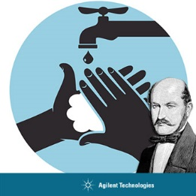
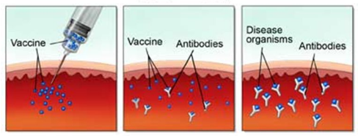
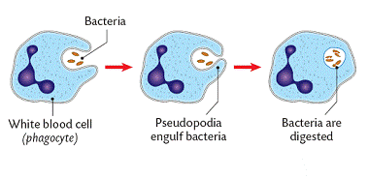
B1 Microorganisms and health
What are pathogens | Microorganisms that cause illness and diseases | MMR vaccinates against… | Mumps, measles and rubella
Pathogen examples | Viruses, bacteria and fungi | How to grow bacterial cultures in the lab | Sterilise the agar plate Sterilise the petri dish Sterilise the inoculation loop by holding it into a roaring Bunsen Burner flame. Transfer bacteria onto agar plate using sterile loop. Place a lid on the petri dish to prevent microorganisms from the air from entering. Secure the lid loosely with selloptape. Make sure it is not sealed completely. Without oxygen entering, very harmful microorganisms would develop inside the petri dish.
How bacteria make us ill | They release toxins into our body
How viruses make us ill | They enter our body cells, multiply inside and then destroy/damage the body cells
How we defend ourselves against pathogens | Produce antitoxins to neutralise the toxins Produce antibodies which attach to the antigens on the surface of pathogens and slow them down White blood cells engulf and ingest pathogens
What important discovery did Semmelweis make? | Handwashing prevents the spread of diseases. He insisted that doctors washed their hands before examining patients. This practice drastically reduced deaths in hospitals.
 |  | At what temperature is the petri dish incubated? | 37ºC in industry 25ºC in schools to prevent harmful bacteria from growing.
How do you treat a bacterial infection? | With antibiotics
How do you treat viral infections? | You cannot, as antibiotics cannot get to the viruses inside body cells. Other medicines however can alleviate the symptoms (e.g. painkillers)
Why should we avoid the overuse of antibiotics? | To prevent the development of superbugs. Due to mutations, some pathogens are resistant to the antibiotic. These pathogens survive and multiply. An example of an antibiotic resistant pathogen is MRSA
How does a vaccination work? | A weak/dead pathogen is injected. The body produces antibodies. When the live pathogen enters the body, the body remembers to the specific antibodies needed and produces it more quickly.

