Slide 1
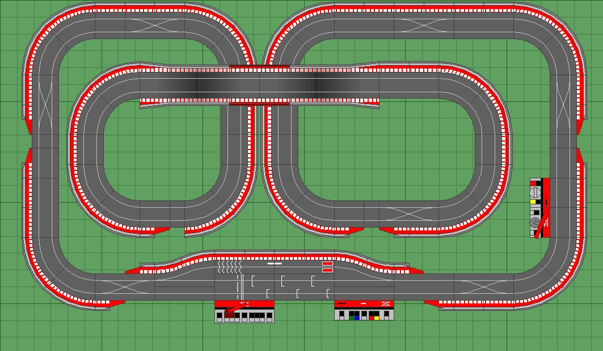
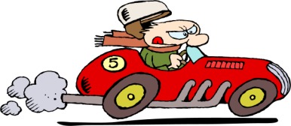
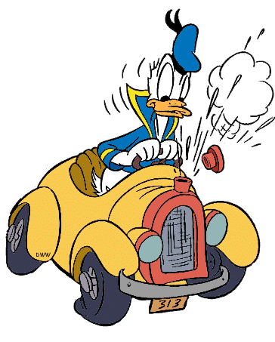
Exam RAce
Rank the topics you need to know for the exam from least confident to most confident. Adjust the race track after each revision session.
Finish
Start

Slide 2
Exam RAce
Rank the topics you need to know for the exam from least confident to most confident. Adjust the race track after each revision session.
Finish
Start

